Slide 1
Prediction of Stock Market Prices
Student: Toma Joksimovic 2016/201222
Professor: Milan Milosavljevic
Course: Artifical Intelligence

Slide 2
What problem is solved?
LSTM Neural Network is optimized type of Reccurent Neural Network which have solved the Vanishing Gradient Problem, where in RNN after learning with too long sequnce of data, our gradients become too small after Backpropagation algorithm.
LSTM solves this problem with internal memory, so it can memorize data for a long-term.
With LSTM we have solved problem of extremely hard and exhausting analysis of Stock Market indicators by humans for predicting future flow of the Stock Market as the main goal.
It shows that machines fastly process huge amount of data, building patterns after finding dependencies in data features.
LSTM shows great accuracy in prediction, inspite of being slower than RNN.

Slide 3
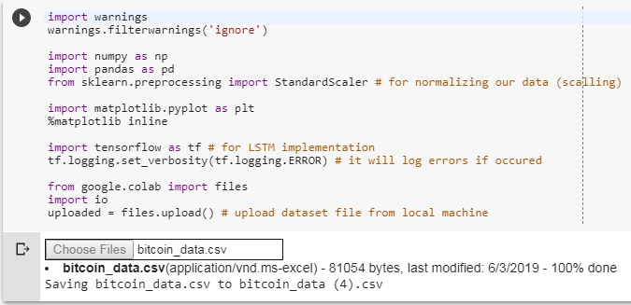
Tools and libraries
Google Colaboratory as development environment with GPUs (SaaS + IaaS)
Programming language: Python 3.6
Libraries:

Slide 4
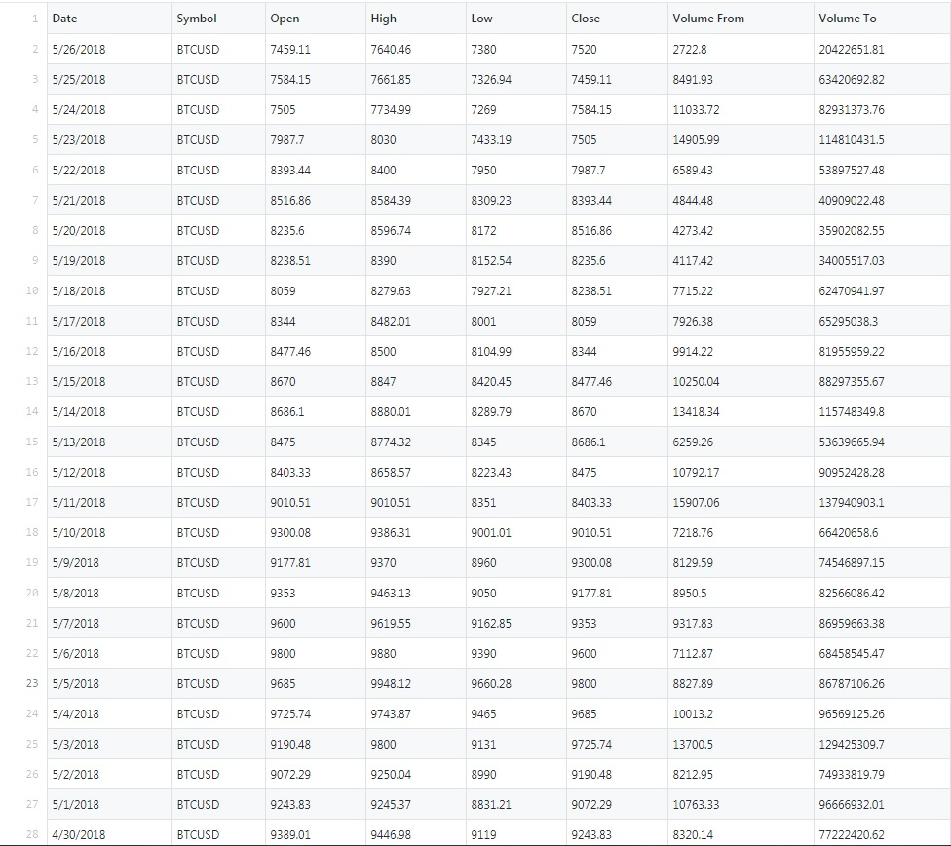
Data Source
Downloaded from historical data on webiste: http://www.cryptodatadownload.com/data/
Bitcoin data from December 2014 to May 2018 in CSV file (1273 records)

Slide 5
Thank you for attention !

